Slide 1

SFWE 301
UA Scholarship Application Management System (UASAMS)
Acceptance Test Review
SFWE 301 - Fall 2025
Team 7:
  Daniel Rivera, Mason Njos, Ernesto Martinez, Evan Harris

Slide 2
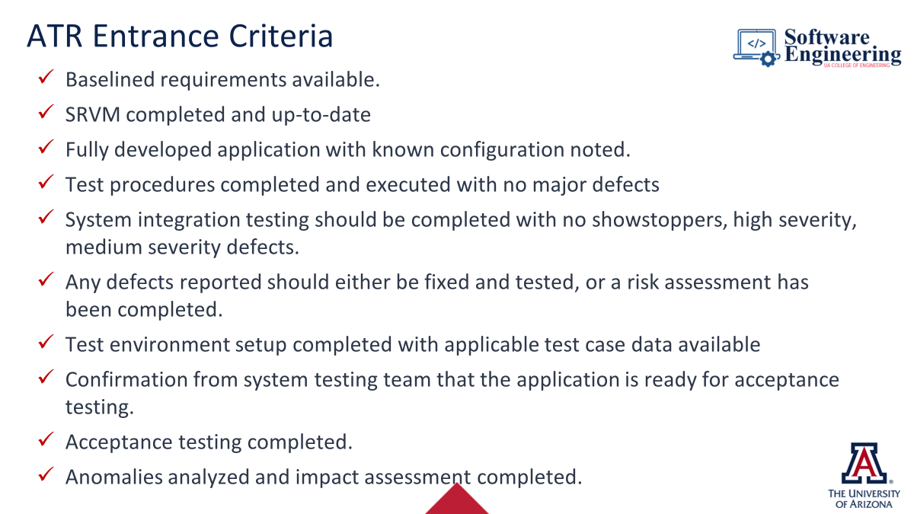
Entrance Criteria
See Module 7, slide 23 (see screenshot to the right)
Tailor to make it relevant to your project and use of Jama

Slide 3
UASAMS Description
  Purpose:
    A system to streamline applications, reviews, awards, and reporting for the College of Engineering
  Key Features:
    Online applications and document uploads
    Automated notification
    Reviewer scoring and selection
    Scholarship-applicant matching
    Reporting and analytic
    Secure, role-based access
Notes:
Took this straight from the conops pdf under objectives

Slide 4
Summary of Final SW Requirements / SRVM
Export your requirements for the entire project – including test methods from Jama)
This will likely take 3-4 pages

Slide 5
Change Requests Summary
Make sure that your change requests (for requirements) are complete, linked to requirements that you are changing and signed by either Prof Sharon or Prof Saldana
You do Not need a change request for any of your test procedures!

Slide 6
Requirement Mapping to Test Procedures
Only required for the subsystem that your team implemented

Slide 7
Test Environment Description
Be sure to describe the test setup including any “canned” data files that you are using to represent students' applications, scholarships, etc.
Are those test files in GitHub?

Slide 8
Test Procedures <and Results>
Export each individual Test Procedure from Jama.
  See announcement for how to do this that was posted to D2L
Make sure that your test procedures are detailed and unambiguous
Two approaches to share results:
  As you share each test procedure – show the results of executing that test at the same time you are showing the test procedure
  The alternative to this is to summarize the results when you do the implementation demonstration.

Slide 9
Code Demonstration / Test Results
If you have already shown the test results with each test procedure, this section will be a demonstration of your team’s implementation.
If you did not show the results for each test procedure when you discussed the test procedure, then this section should also show results of executing each test procedure.

Slide 10
Test Anomalies
Summarize any test anomalies that your implementation has
Be sure to summarize the impact of those anomalies
See rubric for more details

Slide 11
Summary of Waivers
Summarize any waivers that your team has
Waivers should be approved in advance

Slide 12
Overall Evaluation of Test Results
Using the SRVM for your subsystem – indicate for each requirement whether the requirement and test method passed or failed

Slide 13
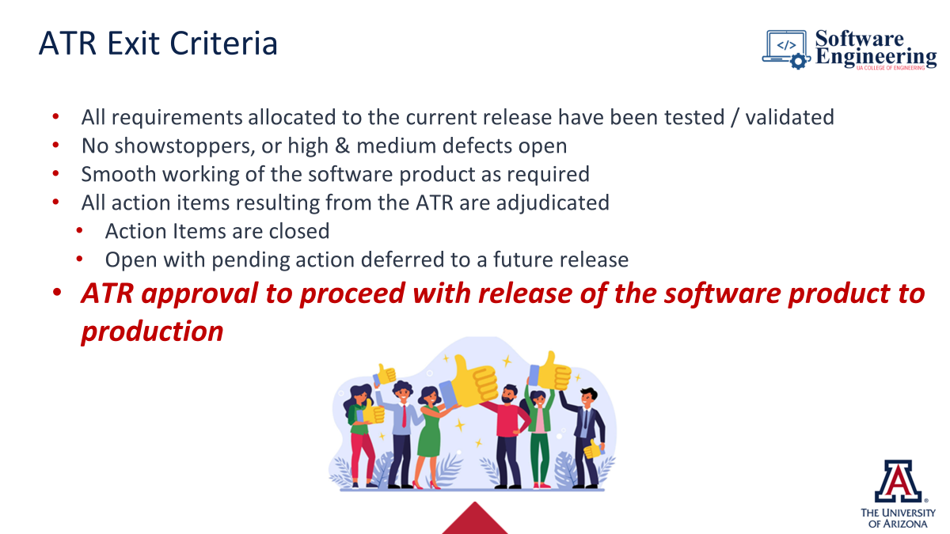
Exit Criteria
See Module 7, slide 24 (see screenshot to the right)
Tailor to make it relevant o your project and use of Jama

